Slide 1
Genetic Incompatibility Lab
BIO 240L Spring 2025
Tyler Gandee, Dr. Karen Barnard-Kubow, Caylin Murray,
Dr. Alfredo López-Caamal, and Dr. Laura Galloway
Notes:
Slides from: Using Nanopore sequencing to assemble and compare chloroplast genomes: introducing genomics and bioinformatics into the classroom. Tyler Gandee, Caylin Murray, Alfredo Lopez-Caamal, Isobel Cobb, Laura F. Galloway, Joseph A. Harsh, Karen B. Barnard-Kubow.

Slide 2
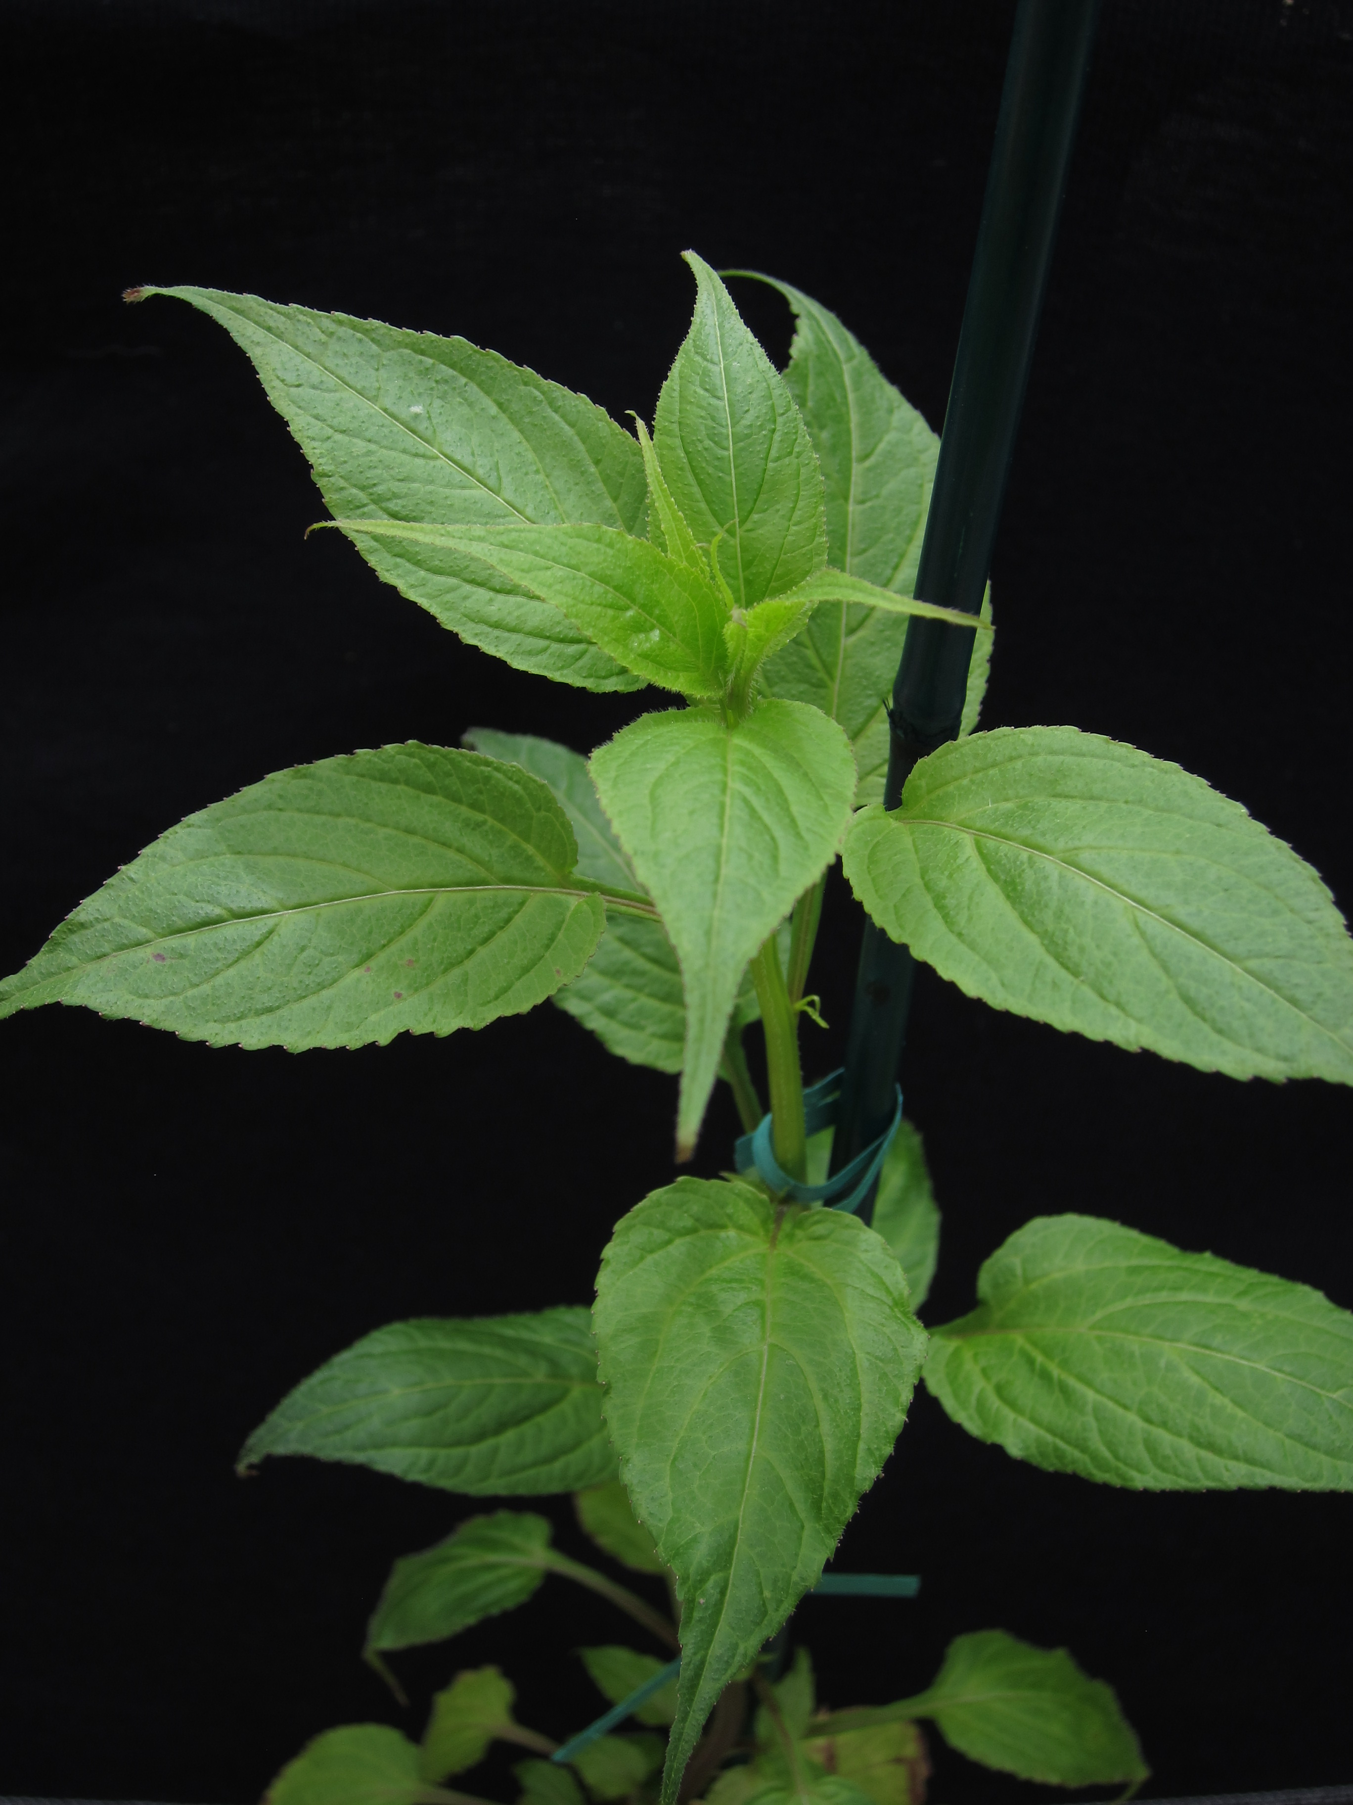
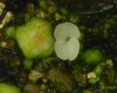
Speciation as a gradual accumulation of genetic incompatibility and thus reproductive isolation
What are evolutionary processes that drive this process?
Notes:
Hi everyone, welcome back. Before we get started on our work today, I wanted to give a quick recap of the project we are working on followed by a more detailed introduction to the bioinformatics analysis we will be working on today. Remember, the overall scientific question that is motivating the work we are doing in this module is what are the evolutionary processes that drive the overall process of speciation.

Slide 3
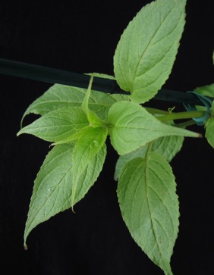
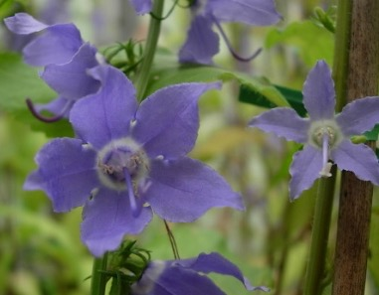
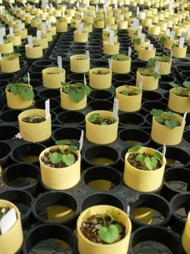
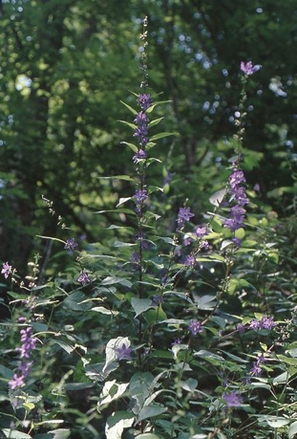
Campanula americana
(American Bellflower)
Notes:
We are addressing this question with the plant system, Campanula americana, which has three divergent genetic lineages based on the chloroplast genome. As long as you cross populations from the same lineage, plants are happy, healthy, and green, but once you start crossing between lineages, you begin to see genetic incompatibility.

Slide 4
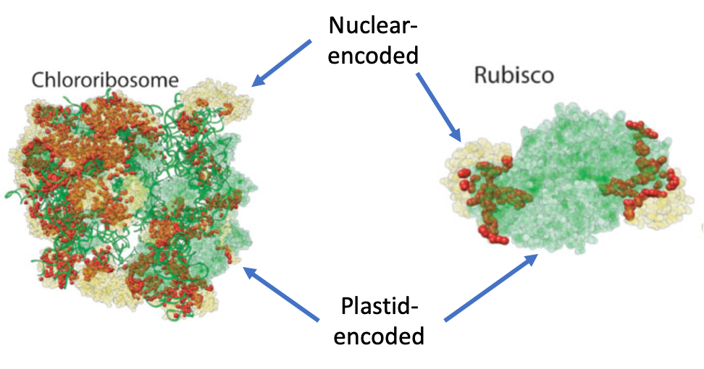
Appalachian
Western
Western
Appalachian
What changes in the chloroplast genome cause this genetic incompatibility?
☺
☹
Notes:
And remember, the direction of the cross is very important, which indicates the organelles are playing an important role in this incompatibility. Specifically, there appears to be a mismatch or genetic incompatibility between the Western lineage chloroplast genome and the Appalachian nuclear genome. Or more specifically, the proteins they produce are no longer working well together. The question we want to address is what genetic changes on the chloroplast side are contributing to this incompatibility.

Slide 5
Is there a relationship between extent of structural variation in the chloroplast genome in C. americana and strength of genetic incompatibility?
Our approach
Cross plants from different genetic lineages
Germinate the seeds and score the strength of genetic incompatibility
Extract DNA from the parental plants and sequence the full chloroplast genome
Assemble the chloroplast genome de-novo
Compare de-novo assemblies from parental plants to score number of structural variants
Graph strength of genetic incompatibility against number of structural variants to determine if there is a relationship
Notes:
As a reminder, these is the stepwise process we are working through to address our question of whether there is a relationship between structural variation in the chloroplast genome and strength of genetic incompatibility in C. americana. This week we will be focusing on steps 4-6, though also phenotyping our seedlings, which is part of 2.

Slide 6
Is there a relationship between extent of structural variation in the chloroplast genome in C. americana and strength of genetic incompatibility?
Our approach
Cross plants from different genetic lineages
Germinate the seeds and score the strength of genetic incompatibility
Extract DNA from the parental plants and sequence the full chloroplast genome
Assemble the chloroplast genome de-novo
Compare de-novo assemblies from parental plants to score number of structural variants
Graph strength of genetic incompatibility against number of structural variants to determine if there is a relationship
Notes:
First, I would like to say a bit more about what it means to assemble a genome de-novo from next generation sequencing data.

Slide 7
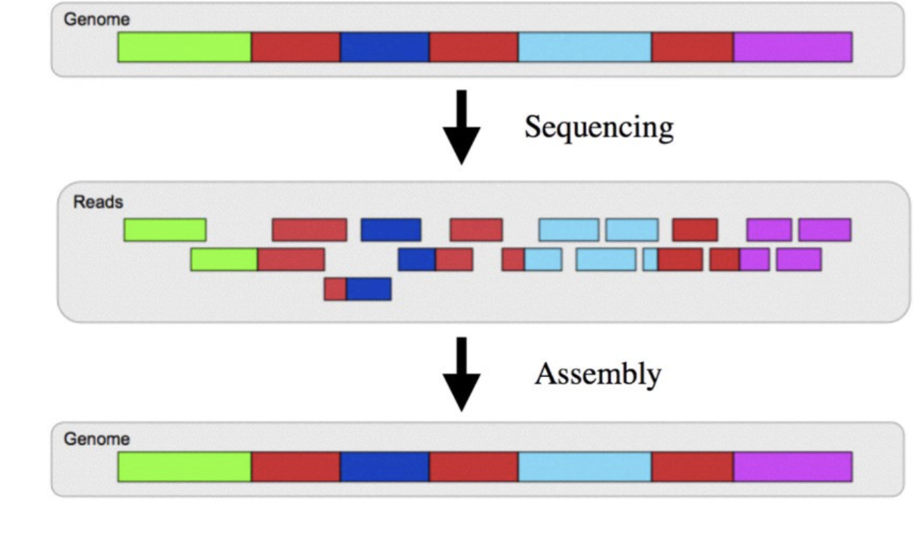
Genome sequencing: assembly
Many copies of the genome were sequenced
Different copies of the genome break/fragment in different places
Some reads will overlap
Computationally identify overlapping regions from each sequencing read
Assemble reads to form contigs
Ideally, one contig for the chloroplast/plastid genome
Notes:
When we extract DNA from a piece of leaf tissue, there are many copies of the chloroplast genome present in that extraction. When we make the Nanopore MinION library, the DNA is randomly cut and adaptors are then added, and then those fragments of DNA are sequenced. What this means, is that each read, or sequence, that comes off the sequencer will begin and end in a different position in the genome. We can use this to our advantage, because it means some of those sequences will overlap, and we can use that overlap to reconstruct the genome sequence. Genome assembly programs are essentially doing just that, computationally identifying overlapping regions from the sequencing reads and then using that to piece them back together. The program assembles the reads into longer, contiguous stretches of DNA sequencer, which are then called contigs (which comes from contiguous). You may also hear the term scaffold used when talking about genome assembly. Scaffold are when the program knows two contigs go next to each other, but it isn’t sure of the sequence in between, in this case it will put a series of Ns in between the two contigs to represent that unknown sequence. When assembling the chloroplast genome, we ideally will get one contig, because remember, the chloroplast genome is a circle, thus it should come out in one piece. However, when the sequence is output as a fasta file, the sequence will appear to have a start and an end, with a break randomly inserted in the sequence to form a line (when reporting DNA sequence in a file, there has to be a beginning and an end, even though it may actually make a circle).

Slide 8
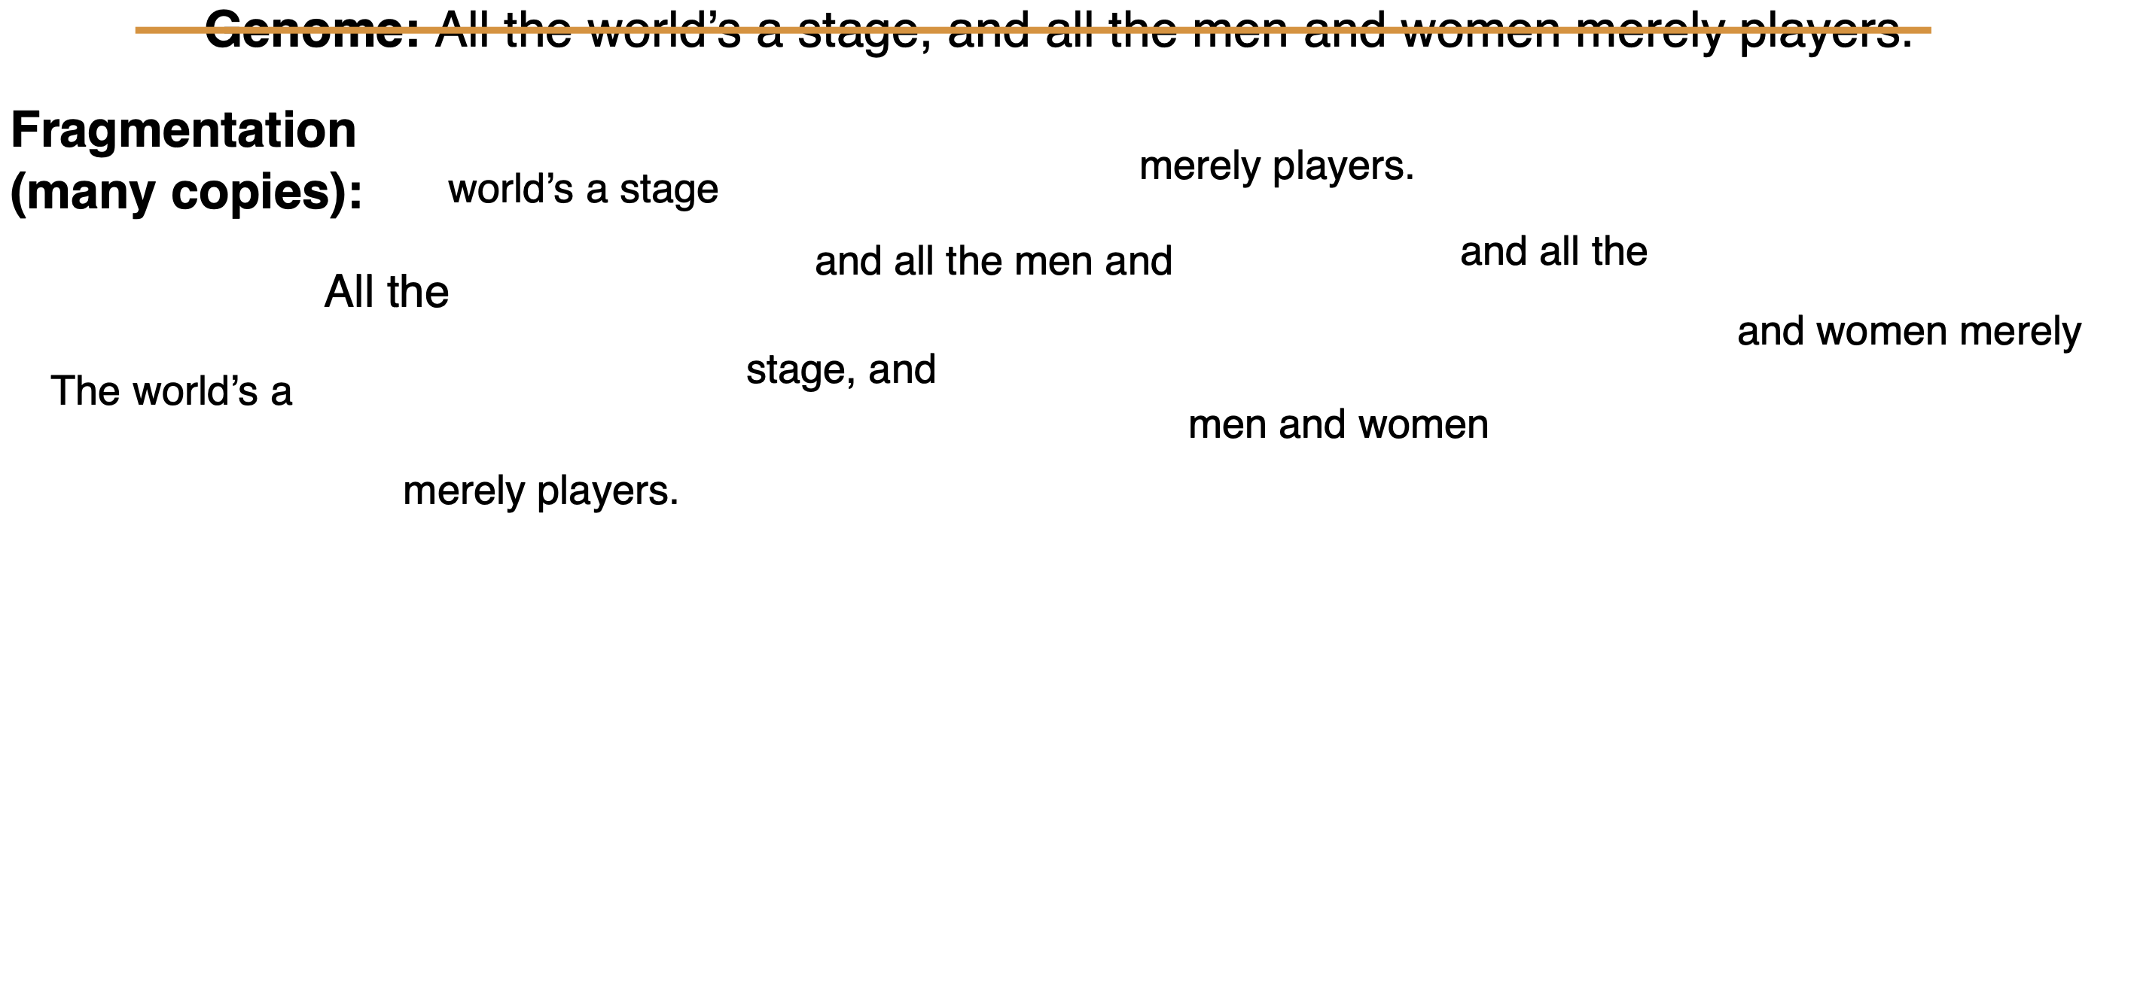
Genome sequencing: assembly
Notes:
To think a bit more about genome assembly, let’s imagine the genome is like a sentence. We want to know the full sentence, but all we have are fragments. We can use the overlap in the fragments, like “men and” or “and women” to start to piece the sentence together.

Slide 9
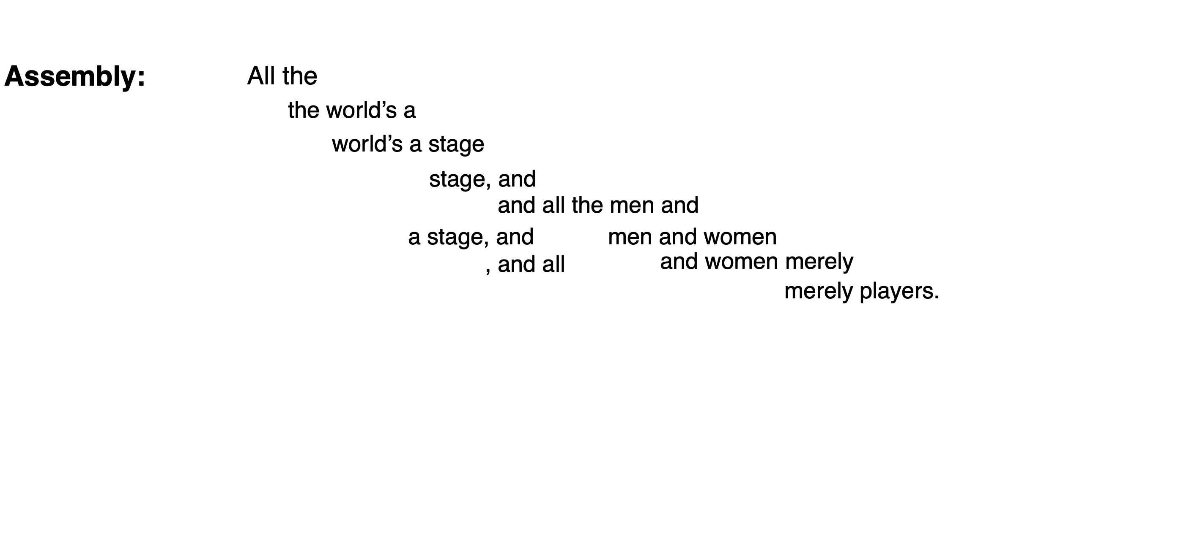
Genome sequencing: assembly
Notes:
Eventually we can line up the fragments to reconstruct the entire original sentence.

Slide 10
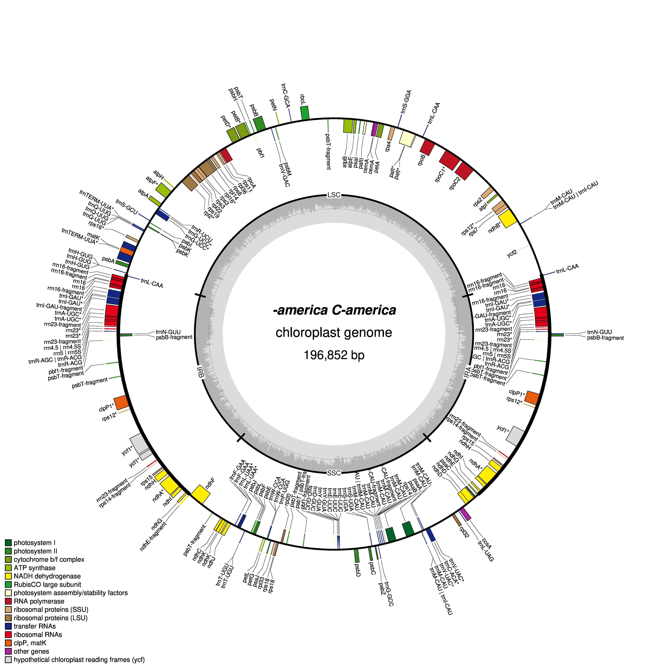
Genome sequencing: assembly
Campanula americana
Notes:
I also wanted to give a quick reminder of what a chloroplast genome looks like and how it is structured. This is the chloroplast genome from Campanula americana. It is almost 200,000 bp long. Each of the colored blocks around the circle represent a gene, and they are colored according to function. For example, green and yellow genes are involved with photosynthesis. Red genes are involved in gene transcription and translation. Remember, the chloroplast genome is quadripartite, meaning it has four parts. We have the pair of inverted repeats, which contain the same genes in the same order. These repeats are separated by the single and large single copy regions. This will be important in a bit.

Slide 11
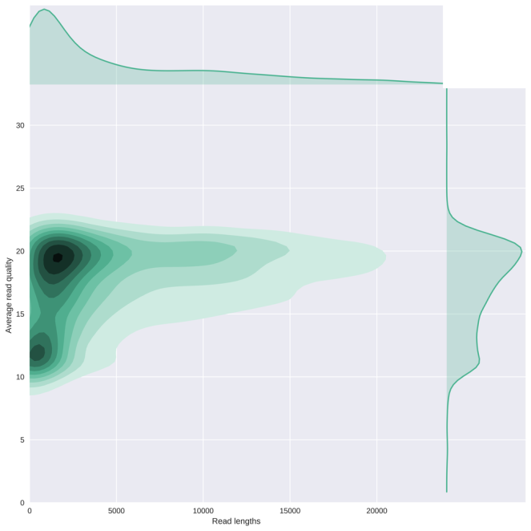
Our approach – using bioinformatics to assemble the chloroplast genome
Basecalling and mapping to chloroplast genome to pull out chloroplast reads
Will be done outside of lab
Quality control using Nanoplot
Distribution of read length, read quality
Notes:
OK, so, now I will walk briefly through each program in the Colab bioinformatics analysis and explain what it does. We already did a run through of the Bioinformatics notebook last time we met, but I think it’s good to make sure we understand what is happening at each step. The first program we run our data through is Nanoplot. Nanoplot enables us to get some information about the quality of our sequencing run, including both read quality and length. What we really want are long, high-quality reads. However, our read length distribution is often skewed a bit towards smaller read lengths. This is because just like Illumina, Nanopore sequencers preferentially sequence smaller fragments of DNA. Overall, better sequencing runs will have higher quality and longer reads. The input file for Nanoplot will be the fastq file that contains all the chloroplast reads for your sample that came off of the MinION sequencer. A fastq file is similar to a fasta file, except it also contains quality information in addition to the sequence (ATCGs) of each read. Remember, when Nanopore’s basecaller is calling the bases for the reads (determining if each position is an A, T, C, or G), it doesn’t “know” that a position is an A for example, it is running a model and making the best choice. This means, for every choice, there is a confidence behind that choice. How confident was the model that there truly was an A at position 1. This confidence is the “quality” score. This is what we are looking at in Nanoplot. This quality information is also used in downstream programs, like Flye (which we use to assemble the genome), as program will place less weight on less confident basecalls.

Slide 12
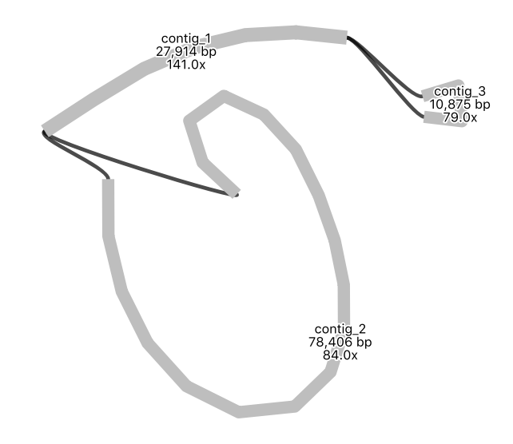
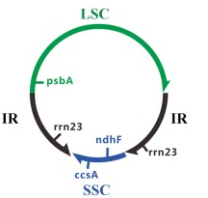
Our approach – using bioinformatics to assemble the chloroplast genome
Basecalling and mapping to chloroplast genome to pull out chloroplast reads
Quality control using Nanoplot
Distribution of read length, read quality
Genome assembly using Flye
How many contigs/pieces? What lengths?
Visualize assembly using Bandage
Do reads support contigs/pieces being connected?
Notes:
We then use the program Flye to assemble the genome from the reads. Flye is essentially computationally identifying overlaps between reads and using those overlaps to piece back together the original chloroplast genome, like the example with the sentence we used earlier. However, instead of trying to assemble 10 fragments into a 13 word sentence, we are now trying to assemble thousands of fragments into a 200,000 bp character genome. This is computationally expensive/hard, and thus this will be the most time intensive step of the bioinformatics analysis. So, please be patient while Flye is running, remember, it is working hard. Fly also takes the fastq file as an input.
We can then visualize the output of the assembly (how many pieces? Circle or line?) using the program Bandage. Bandage takes the graphical fragment assembly file (.gfa file) and generates a graph of the assembly. This enables us to see how many contigs the assembly is in and how those contigs connect to one another. Ideally, we want to see a single circle, reflecting the circular chloroplast genome. However, you may also see this shape here, which I call the dumbbell. This often results when the assembly is in 2-3 pieces. What is happening here, is the inverted repeat has been collapsed into a single sequence. Thus, both ends of the long and short single copies appear to emanate from the same sequence/end of the inverted repeat. So, this middle piece in the graph is the inverted repeat, the small circle coming off one end is the small single copy (SSC) and the large circle coming of the other end is the large single copy (LSC).

Slide 13
Our approach – using bioinformatics to assemble the chloroplast genome
Basecalling and mapping to chloroplast genome to pull out chloroplast reads
Quality control using Nanoplot
Distribution of read length, read quality
Genome assembly using Flye
How many contigs? What length?
Visualize assembly using Bandage
Do reads support contigs connecting?
Annotation using GeSeq
Campanula americana
Notes:
Once you have your genome assembly from Flye, we can use the online program GeSeq to annotate the genome, i.e. to identify the locations of the genes. The graph you see here is what results. A depiction of the chloroplast genome with colored boxes around the outside which indicate genes. Each family of genes has a different color. Whether they are facing the inside or outside of the circle indicates the orientation (which strand) the gene is located on. You use the .fasta output file for this analysis, which is the file that contains the sequence of the assembled genome.

Slide 14
Is there a relationship between extent of structural variation in the chloroplast genome in C. americana and strength of genetic incompatibility?
Our approach
Cross plants from different genetic lineages
Germinate the seeds and score the strength of genetic incompatibility
Extract DNA from the parental plants and sequence the full chloroplast genome
Assemble the chloroplast genome de-novo
Compare de-novo assemblies from parental plants to score number of structural variants
Graph strength of genetic incompatibility against number of structural variants to determine if there is a relationship
Notes:
Once you have assembled, viewed, and annotated the genome from one parent of your seedlings, you now need to get the other parent’s genome from a different group, and pass your genome to another group. To facilitate this, please rename and post your assembly.fasta file in the google drive folder linked in the collab notebook.

Slide 15
Our approach – comparing assemblies to score structural variation
Use Mummer/nucmer to align and compare two genome assemblies
Compare your group’s assembly to another group’s assembly
Use Assemblytics to examine the two-genome alignment and score structural variants
Notes:
The first step of comparing genomes and scoring structural variants involves aligning the two genomes. To do this, we will be using mummer/nucmer. Finally, we will use the program Assemblytics to examine the two-genome alignment and identify/score structural variants.

Slide 16
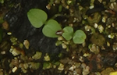
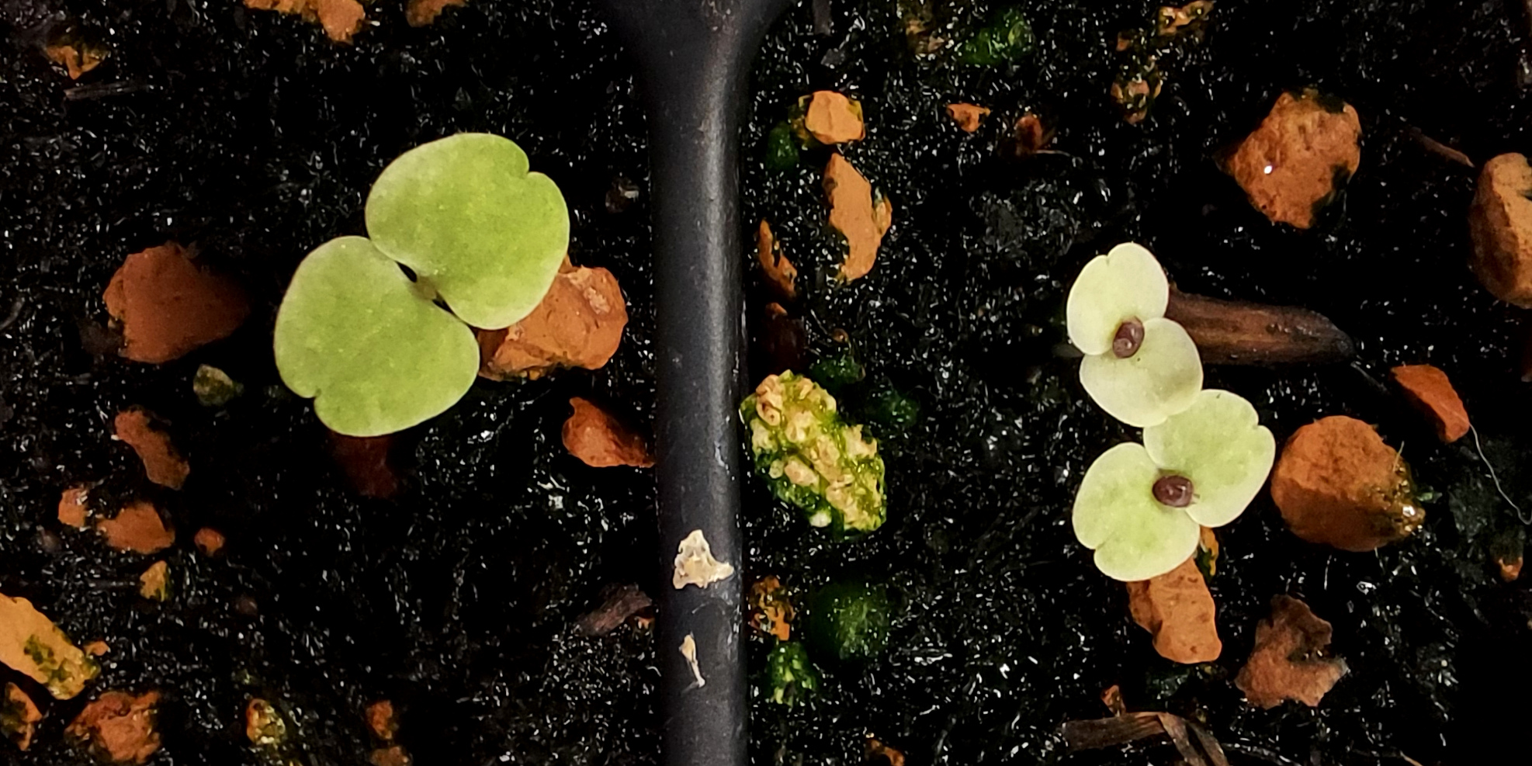
Phenotyping Seedlings
Green: Compatible (None)
Yellow: Moderate incompatibility
White: High incompatibility
Complication
Chloroplast inheritance is not always maternal
If you see a mix of green and white seedlings, green is likely paternal inheritance
Score most incompatible seedlings observed
Western
Appalachian
Notes:
We also need to phenotype our hybrids seedlings today. The best time to do this is while Flye is running, as this step can take up to 20 minutes. Remember, last time we talked about how we can score seedlings as green (compatible/no-incompatibility), yellow (moderate incompatibility) or white (high incompatibility). This sounds straightforward, but in practice it is more complicated. Partly, this is due to patterns of inheritance. Remember, we talked about how organelles are generally maternally inherited. While this is generally the case, it is not always true. It turns out, that while chloroplast inheritance in primarily maternal in C. americana, up to 50% of seedlings, depending on the cross, can inherit their chloroplast from both mom and dad, or only dad. This complicates phenotyping. Because, when you have an Appalachian x Western cross for example, and the hybrid offspring inherits both the compatible (green) Appalachian chloroplast and the incompatible (white) Western chloroplast, you end up with ”variegated” seedlings, which means they can be both green and white in the same seedling. Since all of the seedlings you planted were from crosses where Western or Eastern populations were maternal (incompatible) any green you see is likely paternal inheritance. This also means, that instead of having all white, or all green seedlings, you can end up with a mix. So, how do we score our seedlings, and more importantly, how do we score how incompatible the cross is? I am interested in the variation you see, so I do want you to record all the phenotypes you see (e.g. how many white, yellow, green, and variegated seedlings you see). However, I also want you to assign an overall incompatibility score. For this, you will score the most incompatible seedling observed. So, if you see any white seedlings or partly white seedlings, that would be high incompatibility (3), any yellow would be moderate (2), and all green would be low (1).

Slide 17
What relationship do you expect?
Strength of genetic incompatibility
Number of structural variants
Notes:
OK, so we will then collect everyone’s data, make a graph with number of structural variants on the x and strength of incompatibility on the y, and ask if we see a relationship.

